Slide 1
Classroom slides - Datapath

Slide 2
input
register
clock
output

Slide 3
Rising
edge
Falling
edge

Slide 4
Address
Data in
Read/write
memory
Data out

Slide 5
PC
memory
Addr Din
Dout
Register-file
IR
ALU

Slide 6
PC -> memory -> IR
regs -> ALU -> reg

Slide 7
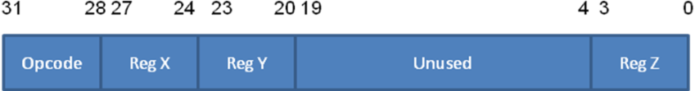
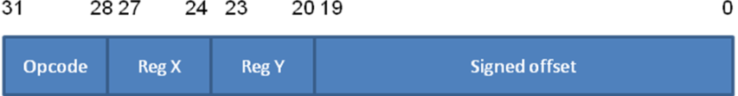
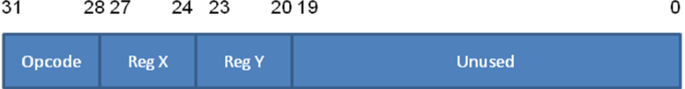
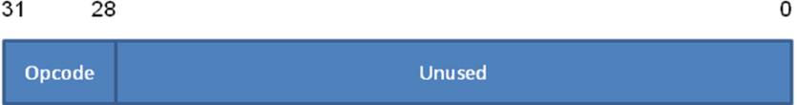
R-type instructions (add, nand)
I-type instructions (addi, lw, sw, beq)
J-type instructions (jalr)
O-type instructions (halt)

Slide 8
PC
memory
Addr Din
Dout
Register-file
IR
ALU

Slide 9
Example 3: Given the following parameters (all in picoseconds),
determine the minimum clock width of the system.
D_{r-ouput-stable} (PC output stable) - 20 ps
D_{wire-PC-Addr} (wire delay from PC to Addr of Memory) - 250 ps
D_{mem-read} (Memory read) - 1500 ps
D_{wire-Dout-IR} (wire delay from Dout of Memory to IR) - 250 ps
D_{r-setup} (setup time for IR) - 20 ps
D_{r-hold} (hold time for IR) - 20 ps
D_{wire-IR-regfile} (wire delay from IR to Register file) - 250 ps
D_{regfile-read} (Register file read) - 500 ps
D_{wire-regfile-ALU} (wire delay from Register file to input of ALU) - 250 ps
D_{ALU-OP} (time to perform ALU operation) - 100 ps
D_{wire-ALU-regfile} (wire delay from ALU output to Register file) - 250 ps
D_{regfile-write} (time for writing into a Register file) - 500 ps

Slide 10
PC
memory
Addr Din
Dout
Register-file
IR
Lot of wires!
ALU

Slide 11
Functional
Unit
Functional
Unit
Functional
Unit
CLK
CLK
CLK
Drive
Drive
Drive

Slide 12
PC
IR
Register-file
Addr Din
memory
Dout
ALU

Slide 13
PC
Register-file
(DPRF)
Addr Din
memory
IR
Dout
ALU

Slide 14
PC
Register-file
(DPRF)
Addr Din
memory
IR
Dout
ALU
PC -> MEM ->IR

Slide 15
PC
Register-file
(DPRF)
Addr Din
memory
IR
Dout
ALU
REG(SRC REGS) -> ALU -> REG(DST)

Slide 16
S1
S2
S3

Slide 17
1
0
3
up
down
2
Transition number | Input | State Current Next | Output
0 | None | Down Down | None
1 | None | Up Up | None
2 | Clicker | Down Up | Up motor
3 | Clicker | Up Down | Down motor

Slide 18
DownControl
Down
motor
clicker
Combination logic
UpControl
Up
motor
D
Up
Q
state
Down
NextState
Q
CLK

Slide 19
DownControl = Up.Clicker
UpControl = Down.Clicker
NextState = Up.Clicker + Down.Clicker

Slide 20
DownControl | UpControl | NextState
0 | 0 | 0
0 | 0 | 1
0 | 1 | 1
1 | 0 | 0
A
D
D
R
E
S
S
00
clicker
01
10
11
Down
motor
Up
motor
Up
D
Q
state
Down
CLK
Q

Slide 21
Fetch
Decode
Execute

Slide 22
registers
16x
32 bits
Din
WrREG
4
regno
Dout

Slide 23
LC
-
2200 Datapath
32
LdPC
PC
LdA
A
B
LdB
LdMAR
MAR
LdIR
IR
32
WrREG
Din
Addr
Din
IR[31..0]
2
registers
WrMEM
memory
ALU:
4
16x
2³² x
func
IR[19..0]
00: ADD
regno
32 bits
32 bits
01: NAND
20
10: A
-
B
Dout
Dout
11: A + 1
sign
extend
DrPC
DrALU
DrREG
DrMEM
DrOFF
=0?
IR[27..24]
Rx: 4
-
bit register number to control logic
1
IR[23..20]
Ry: 4
-
bit register number to control logic
LdZ
Z
IR[3..0]
Rz: 4
-
bit register number to control logic
IR[31..28]
OP: 4
-
bit
opcode
to control logic
1
Z: 1
-
bit
boolean
to control logic

Slide 24
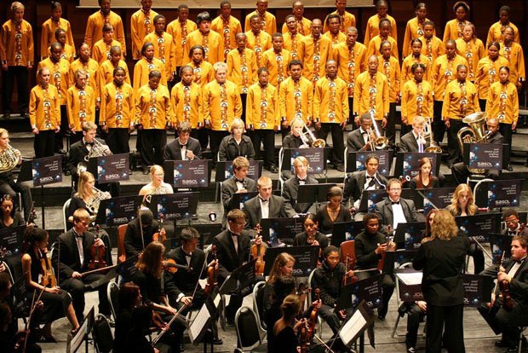

Slide 25
LC
-
2200 Datapath
32
LdPC
PC
LdA
A
B
LdB
LdMAR
MAR
LdIR
IR
32
WrREG
Din
Addr
Din
IR[31..0]
2
registers
WrMEM
memory
ALU:
4
16x
2³² x
func
IR[19..0]
00: ADD
regno
32 bits
32 bits
01: NAND
20
10: A
-
B
Dout
Dout
11: A + 1
sign
extend
DrPC
DrALU
DrREG
DrMEM
DrOFF
=0?
IR[27..24]
Rx: 4
-
bit register number to control logic
1
IR[23..20]
Ry: 4
-
bit register number to control logic
LdZ
Z
IR[3..0]
Rz: 4
-
bit register number to control logic
IR[31..28]
OP: 4
-
bit
opcode
to control logic
1
Z: 1
-
bit
boolean
to control logic

Slide 26
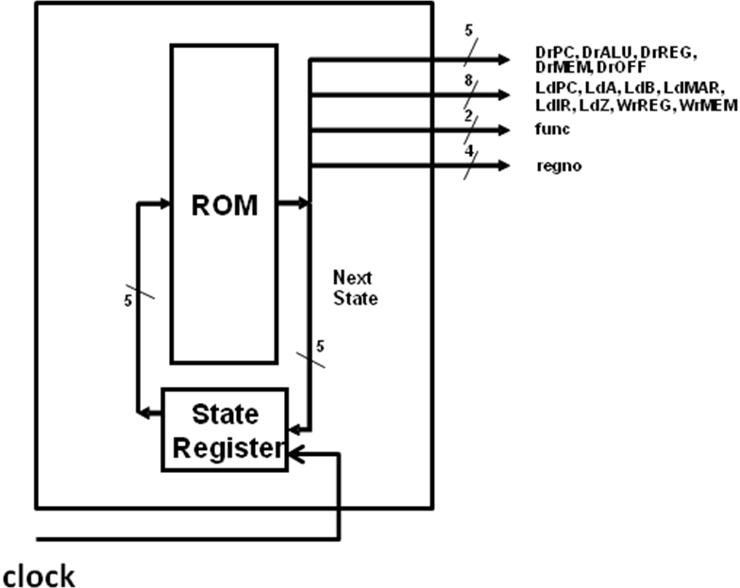

Slide 27
 | Drive Signals |  |  |  |  | Load Signals |  |  |  |  |  | Write Signals
Current State | PC | ALU | Reg | MEM | OFF | PC | A | B | MAR | IR | Z | MEM | REG | func | regno

Slide 28
 | Drive Signals |  |  |  |  | Load Signals |  |  |  |  |  | Write Signals
Current State | PC | ALU | Reg | MEM | OFF | PC | A | B | MAR | IR | Z | MEM | REG | func | regno | Next State
...

Slide 29
LC
-
2200 Datapath
32
LdPC
PC
LdA
A
B
LdB
LdMAR
MAR
LdIR
IR
32
WrREG
Din
Addr
Din
IR[31..0]
2
registers
WrMEM
memory
ALU:
4
16x
2³² x
func
IR[19..0]
00: ADD
regno
32 bits
32 bits
01: NAND
20
10: A
-
B
Dout
Dout
11: A + 1
sign
extend
DrPC
DrALU
DrREG
DrMEM
DrOFF
=0?
IR[27..24]
Rx: 4
-
bit register number to control logic
1
IR[23..20]
Ry: 4
-
bit register number to control logic
LdZ
Z
IR[3..0]
Rz: 4
-
bit register number to control logic
IR[31..28]
OP: 4
-
bit
opcode
to control logic
1
Z: 1
-
bit
boolean
to control logic

Slide 30
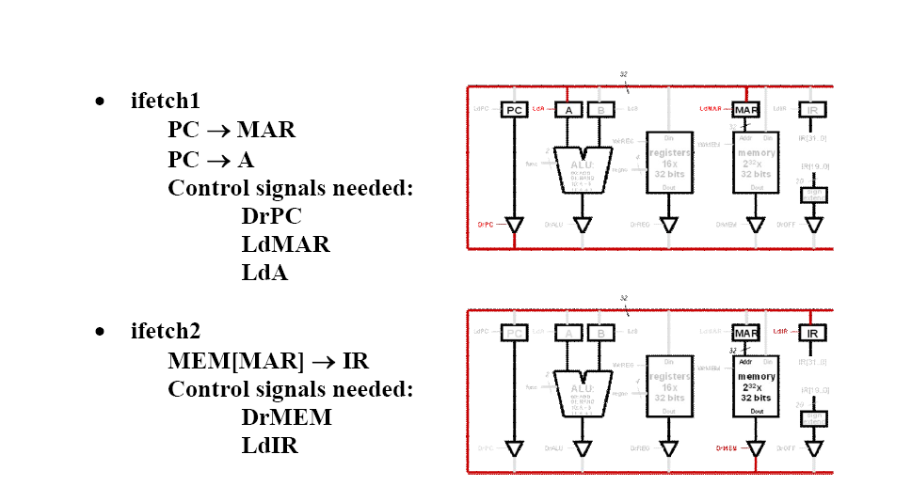
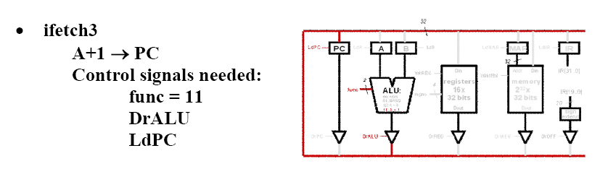

Slide 31
 |  | Drive Signals |  |  |  |  | Load Signals |  |  |  |  |  | Write Signals
Current State | State Num | PC | ALU | Reg | MEM | OFF | PC | A | B | MAR | IR | Z | MEM | REG | Func | regno | Next State
ifetch1 | 0000 | 1 | 0 | 0 | 0 | 0 | 0 | 1 | 0 | 1 | 0 | 0 | 0 | 0 | xx | xxxx | 0001
ifetch2 | 0001 | 0 | 0 | 0 | 1 | 0 | 0 | 0 | 0 | 0 | 1 | 0 | 0 | 0 | xx | xxxx | 0010
ifetch3 | 0010 | 0 | 1 | 0 | 0 | 0 | 1 | 0 | 0 | 0 | 0 | 0 | 0 | 0 | 11 | xxxx | TBD

Slide 32
Fetch
R-Type
O-Type
I-Type
J-Type

Slide 33
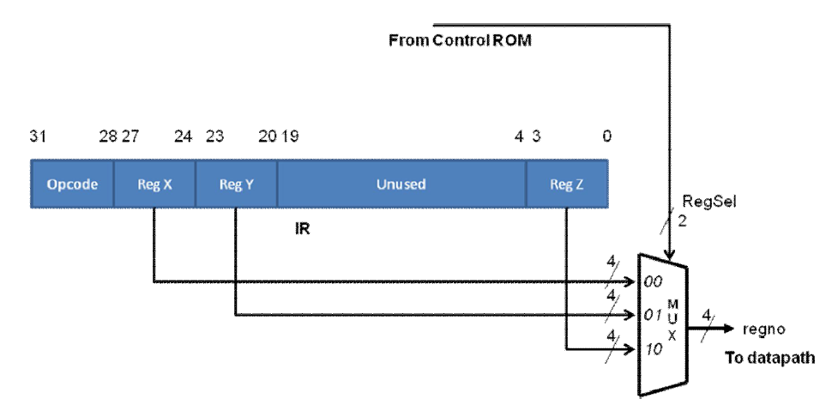

Slide 34
LC
-
2200 Datapath
32
LdPC
PC
LdA
A
B
LdB
LdMAR
MAR
LdIR
IR
32
WrREG
Din
Addr
Din
IR[31..0]
2
registers
WrMEM
memory
ALU:
4
16x
2³² x
func
IR[19..0]
00: ADD
regno
32 bits
32 bits
01: NAND
20
10: A
-
B
Dout
Dout
11: A + 1
sign
extend
RegSel
DrPC
DrALU
DrREG
DrMEM
DrOFF
2
4
=0?
RX
00
IR[27..24]
4
M
U
X
1
IR[23..20]
RY
01
4
LdZ
Z
IR[3..0]
4
regno
IR[31..28]
RZ
10
1

Slide 35
 | Drive Signals |  |  |  |  | Load Signals |  |  |  |  |  | Write Signals
Current State | PC | ALU | Reg | MEM | OFF | PC | A | B | MAR | IR | Z | MEM | REG | func | regno RegSel | Next State
...

Slide 36
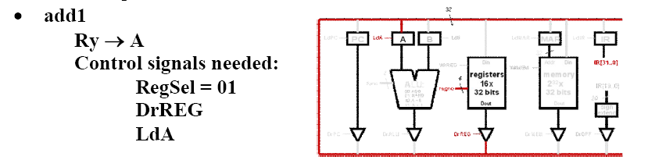
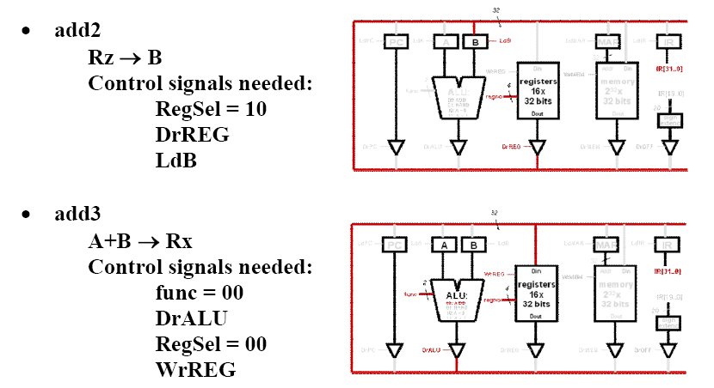

Slide 37
ifetch1
Back to
FETCH
.
.
.
add1
add2
add3

Slide 38
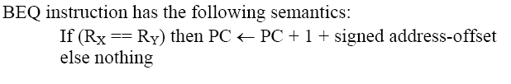
BEQ

Slide 39
LC
-
2200 Datapath
32
LdPC
PC
LdA
A
B
LdB
LdMAR
MAR
LdIR
IR
32
WrREG
Din
Addr
Din
IR[31..0]
2
registers
WrMEM
memory
ALU:
4
16x
2³² x
func
IR[19..0]
00: ADD
regno
32 bits
32 bits
01: NAND
20
10: A
-
B
Dout
Dout
11: A + 1
sign
extend
RegSel
DrPC
DrALU
DrREG
DrMEM
DrOFF
2
4
=0?
RX
00
IR[27..24]
4
M
U
X
1
IR[23..20]
RY
01
4
LdZ
Z
IR[3..0]
4
regno
IR[31..28]
RZ
10
1

Slide 40
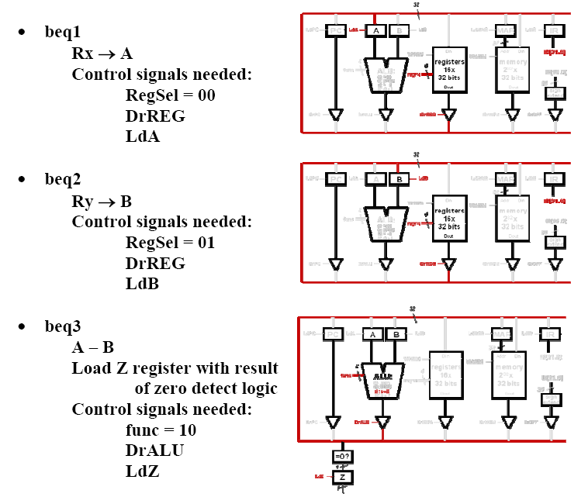

Slide 41
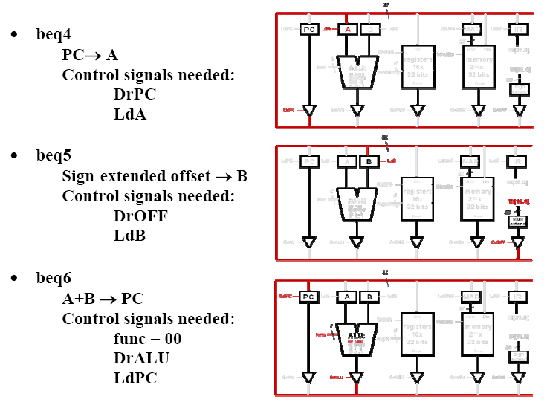

Slide 42
 | Drive Signals |  |  |  |  | Load Signals |  |  |  |  |  | Write Signals
Current State | PC | ALU | Reg | MEM | OFF | PC | A | B | MAR | IR | Z | MEM | REG | func | RegSel | Next State
beq1 |  |  |  |  |  |  |  |  |  |  |  |  |  |  |  | beq2
beq2 |  |  |  |  |  |  |  |  |  |  |  |  |  |  |  | beq3
beq3 |  |  |  |  |  |  |  |  |  |  |  |  |  |  |  | beq4 or ifetch1
beq4 |  |  |  |  |  |  |  |  |  |  |  |  |  |  |  | beq5
beq5 |  |  |  |  |  |  |  |  |  |  |  |  |  |  |  | beq6
beq6 |  |  |  |  |  |  |  |  |  |  |  |  |  |  |  | ifetch1

Slide 43
ifetch1
Z = 0
.
.
.
beq1
beq2
beq3
Z = 1
beq4
beq5
beq6

Slide 44
ROM address = 001000
Ifetch1-clone
Z = 0
.
.
beq1
beq2
beq3
Z = 1
beq4
beq5
beq6
ROM address = 101000

Slide 45
Fetch
ADD
O-Type
000010000
NAND
J-Type
……..
000110000

Slide 46
 | Drive Signals |  |  |  |  | Load Signals |  |  |  |  |  | Write Signals |  |  |  | NextState and modifiers
Current | PC | ALU | Reg | MEM | OFF | PC | A | B | MAR | IR | Z | MEM | REG | Func | RegSel | NextState | M | T

Slide 47
M
O
D
I
F
I
E
R
5
OP
4
DrPC, DrALU, DrREG,
8
DrMEM, DrOFF
Datapath
LdPC, LdA, LdB, LdMAR,
2
5
2
LdIR, LdZ, WrREG, WrMEM
func
Z
1
2
RegSel
10
ROM
24
2
M, T
Next
State
5
State
5
Register
clock

Slide 48
O
R
P
L
A
N
E
I
N
P
U
T
S
AND PLANE
OUTPUTS

Slide 49
Control Regime | Pros | Cons | Comment | When to use | Examples
Micro-programmed | Simplicity, maintainability, flexibility Rapid prototyping | Potential for space and time inefficiency | Space inefficiency may be mitigated with vertical microcode Time inefficiency may be mitigated with prefetching | For complex instructions, and for quick non-pipelined prototyping of architectures | PDP 11 series, IBM 360 and 370 series, Motorola 68000, complex instructions in Intel x86 architecture
Hardwired | Amenable for pipelined implementation Potential for higher performance | Potentially harder to change the design Longer design time | Maintainability can be increased with the use of structured hardware such as PLAs and FPGAs | For High performance pipelined implementation of architectures | Most modern processors including Intel Pentium series, IBM PowerPC, MIPS

